Slide 1
Unity3D: 기초
Asset Store
User Interface
Component (C# script)
3D FBX Model
Input Manager
Vector3
Animator / Animation
Camera control (Cinemachine)

Slide 2
강사
이름 : 박 정호 (구릉)
경력 : 13연차 (Unity3D – 10년)
업종 : Logistic Company
업무 : Develop Digital Twin Software

Slide 3
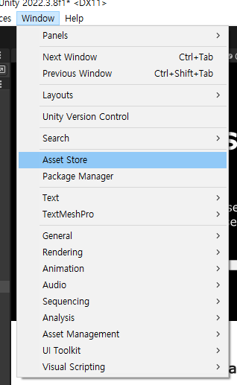
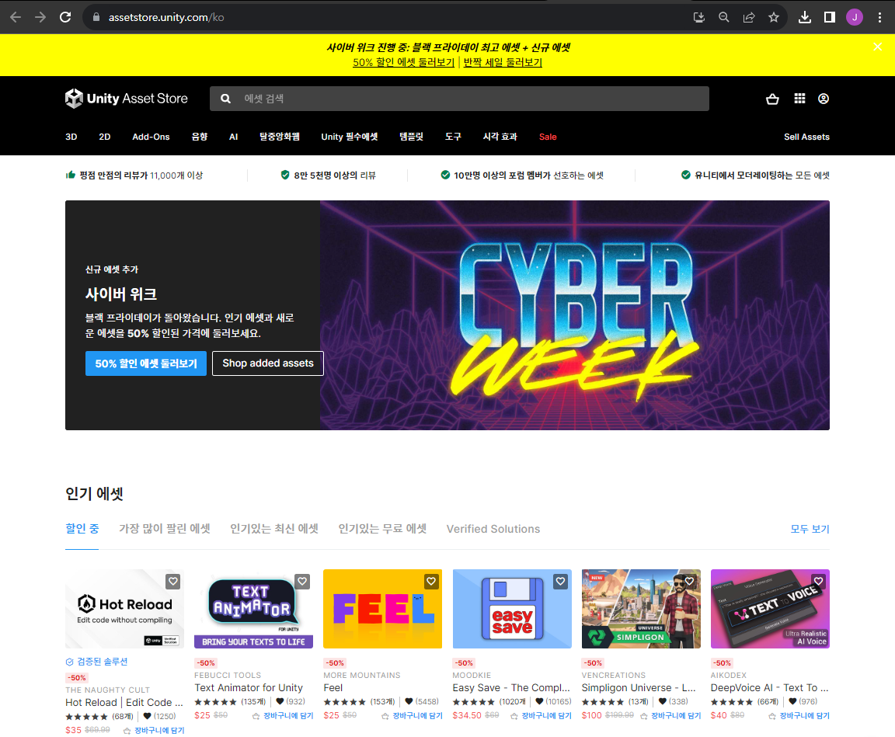
Asset Store

Slide 4
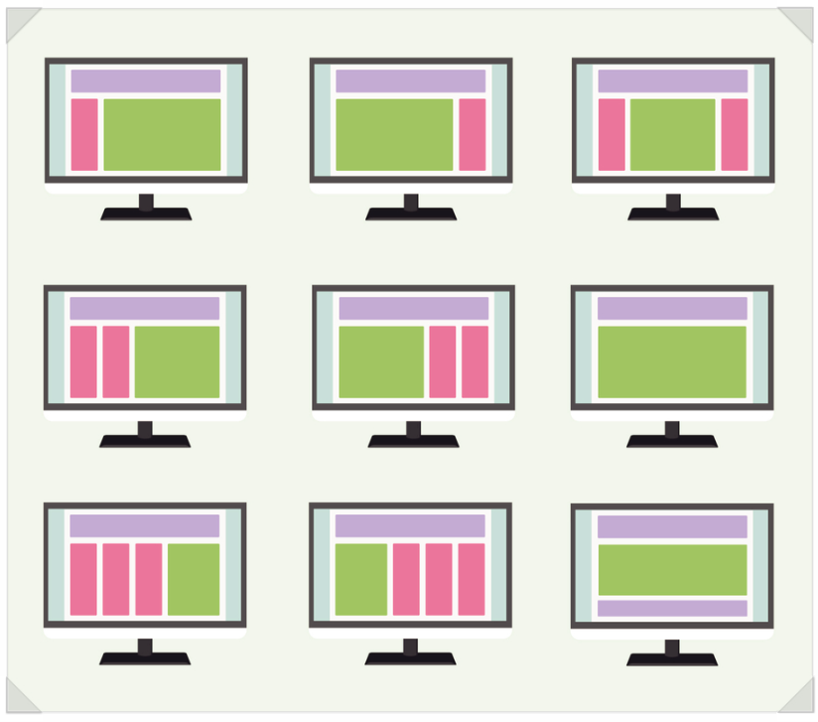
User Interface

Slide 5
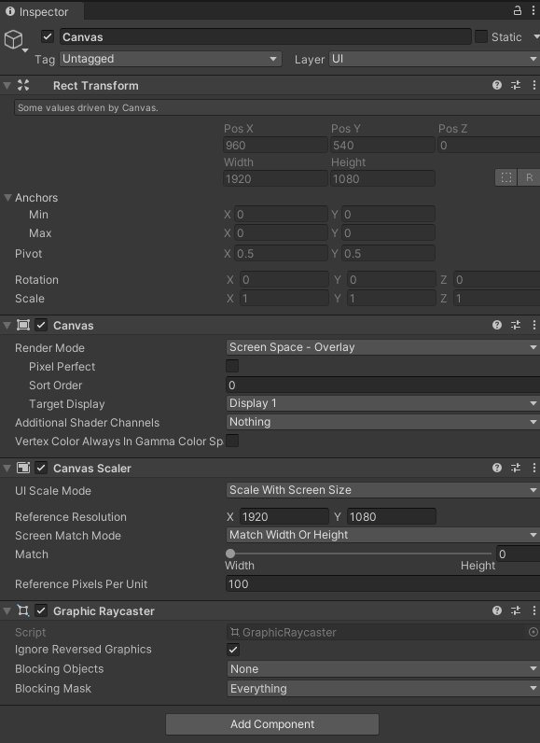
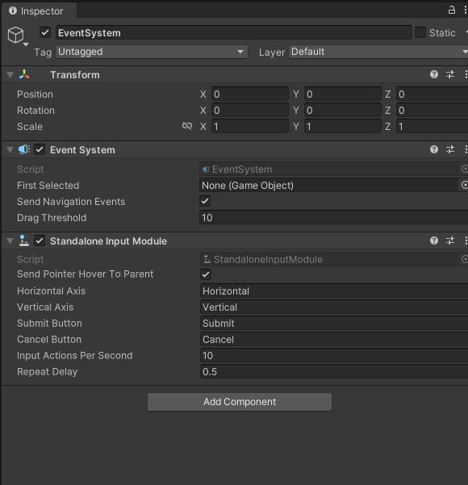
User Interface

Slide 6
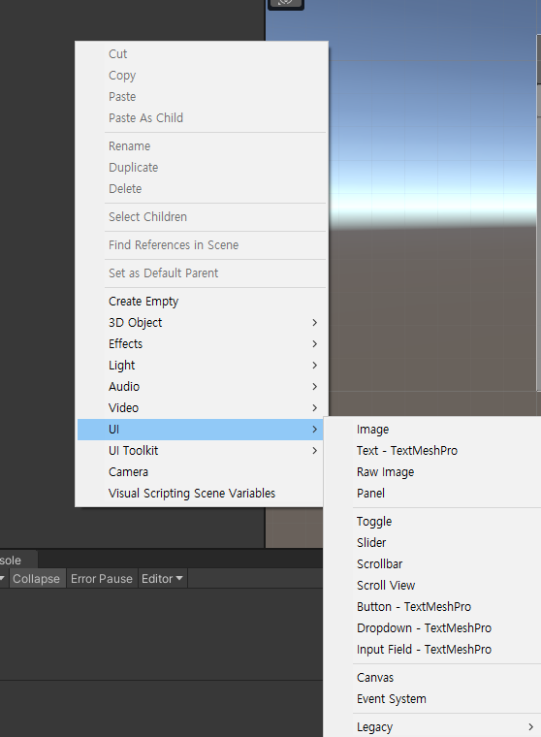
User Interface
자주 사용하는 UI
Image
Button
Scroll View
Slider
Toggle

Slide 7
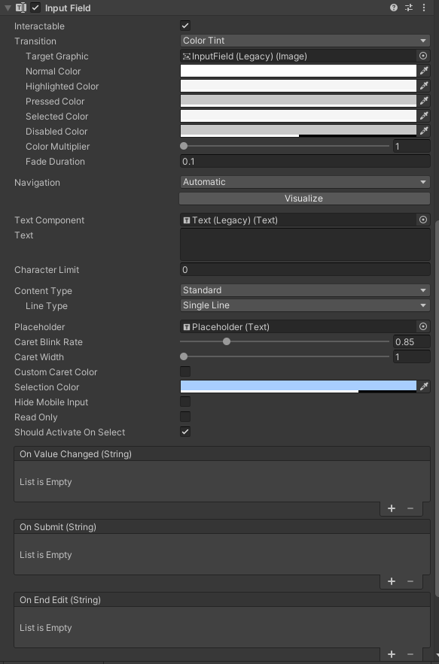
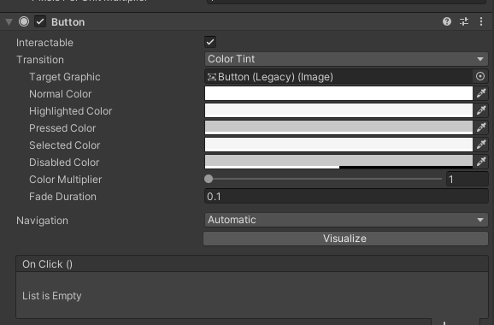
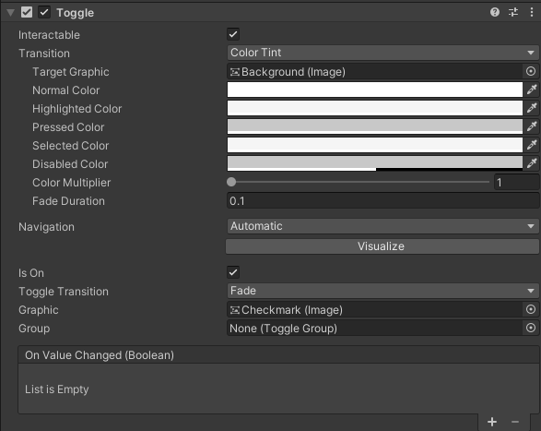
User Interface

Slide 8
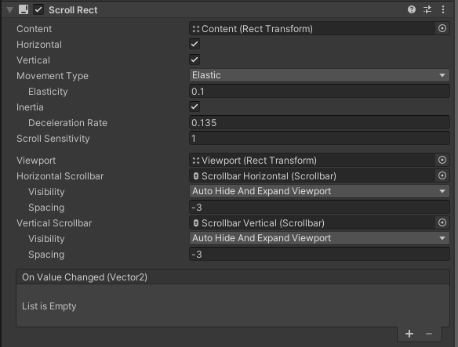
User Interface
같이 사용되어지는 컴포넌트
Content Size Filter
Grid Layout Group
Horizontal Layout Group
Vertical Layout Group

Slide 9
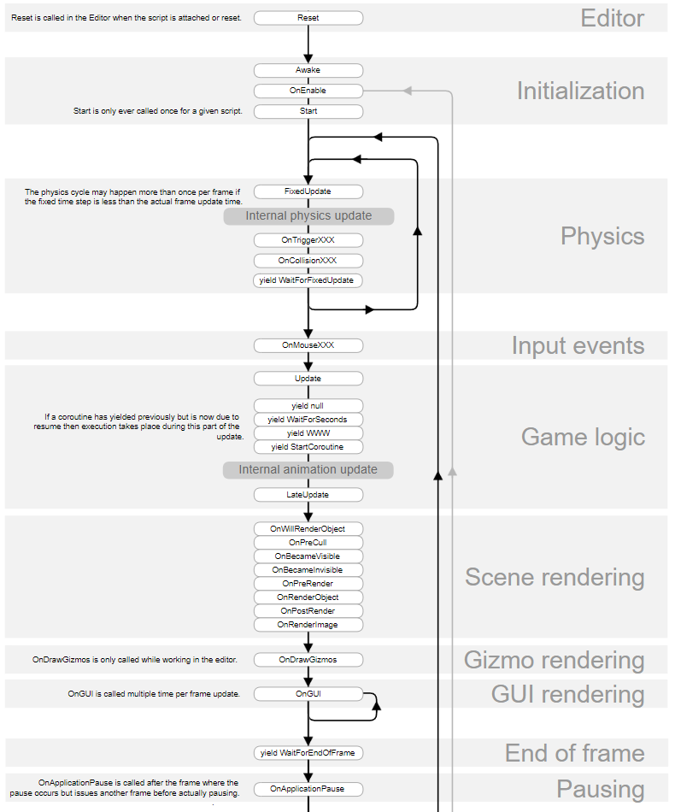
Component (C# Script)
Unity Library에 선언되어있는 함수
Awake
Start
FixedUpdate
Update
LastUpdate
OnXXXXXXXX

Slide 10
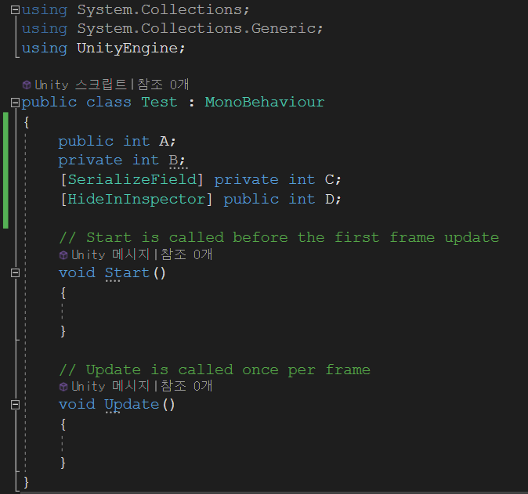
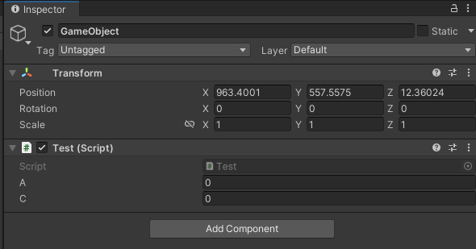
Component (C# Script)

Slide 11
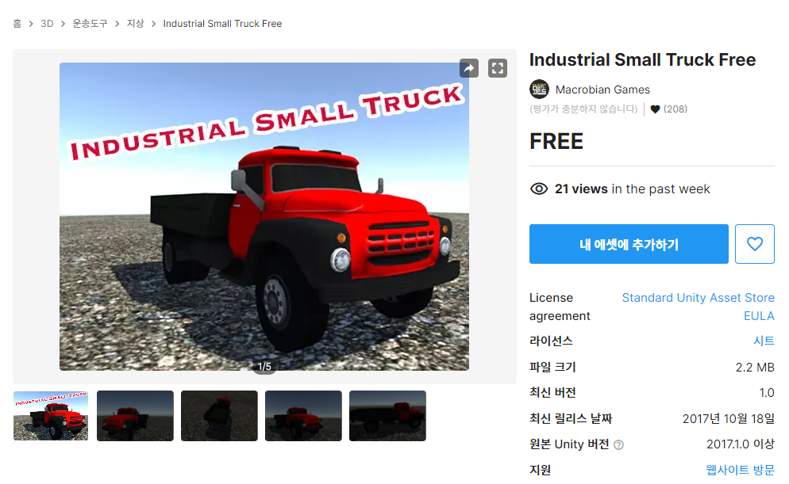
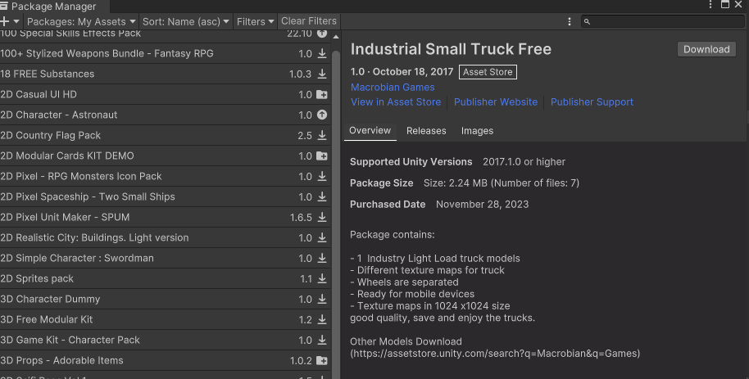
3D FBX Model

Slide 12
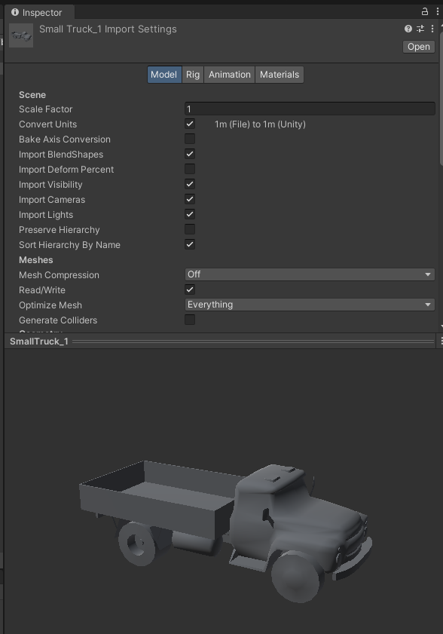
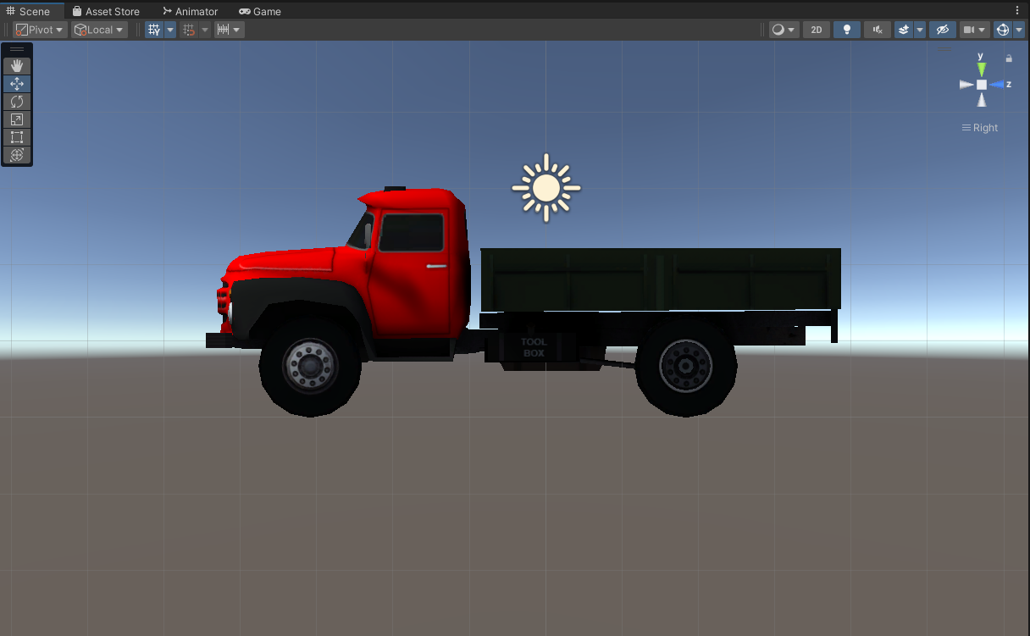
3D FBX Model
1M

Slide 13
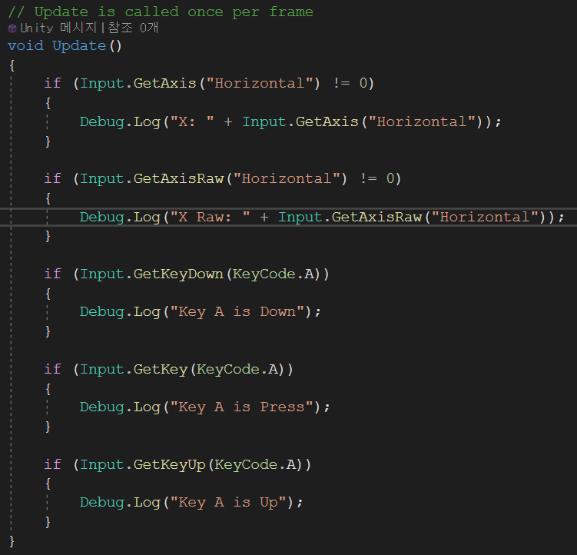
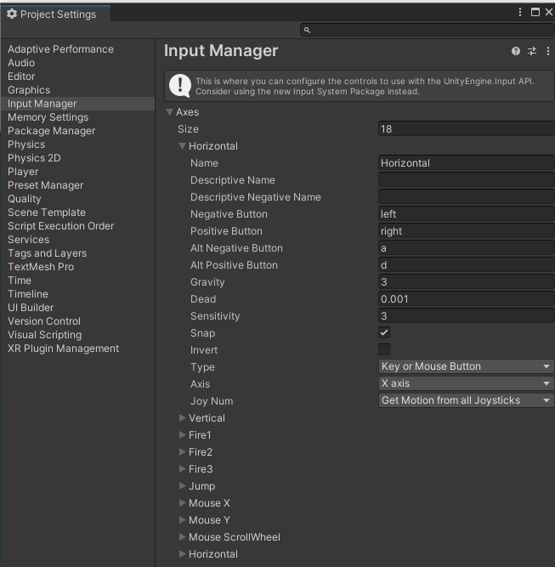
Input Manager

Slide 14
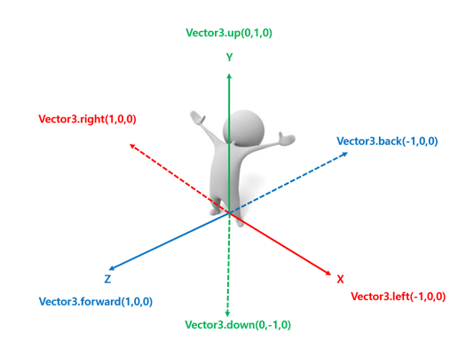
Vector3
float
float[2] == Vector2
float[3] == Vector3

Slide 15
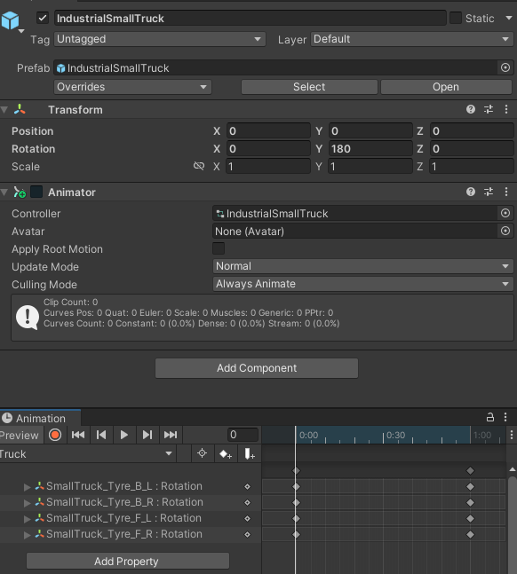
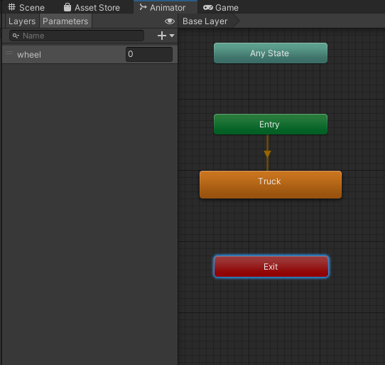
Animator / Animation
중심축을 항상 고려 해야 함

Slide 16
감사합니다

